Slide 1

Welcome

Slide 2
Clustering and Classification of E-commerce Products Using Machine Learning
Name : Deepti Horakeri
Batch : B5 July Online

Slide 3
Web Scrapping:
Objective:
To collect real-world product data from an e-commerce website.
Extract key product attributes for analysis and modeling.
Tools & Libraries:
Python
BeautifulSoup for HTML parsing
Requests for HTTP requests
re for data cleaning (review count)
Pandas for DataFrame creation and CSV export

Slide 4
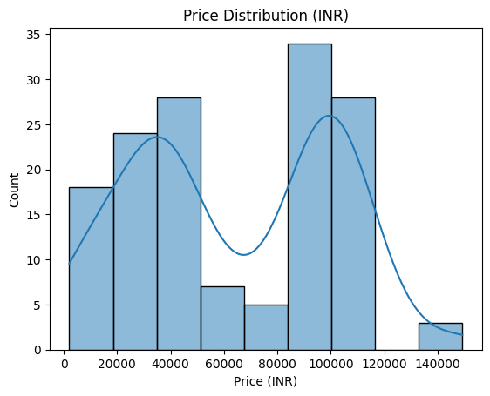
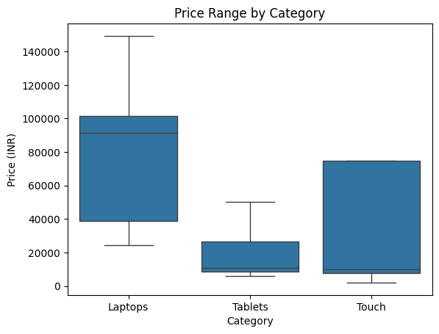
Exploratory Data Analysis

Slide 5
Storage and Cleaning:
Store the cleaned and structured product data for efficient access and future use.
Enable integration with machine learning pipelines and BI tools.
Cleaned data was loaded into a Pandas DataFrame.
Database schema defined with appropriate data types (e.g., TEXT, REAL, INTEGER).
Table created (e.g., products) using SQLAlchemy.
Data pushed from DataFrame to database using .to_sql() method.

Slide 6
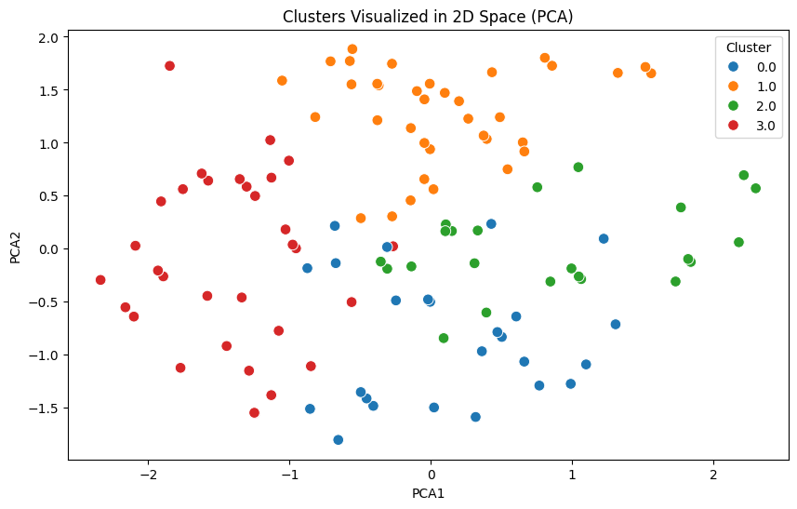
Unsupervised Learning: Clustering

Slide 7
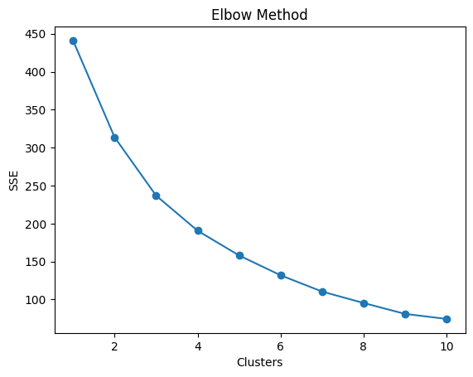
Elbow Method:

Slide 8
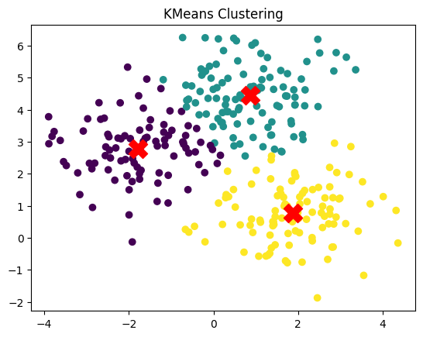
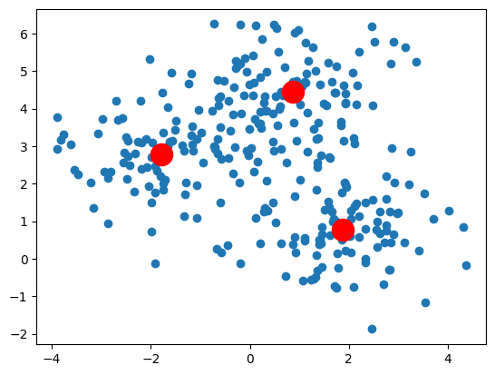
K means Clustering:

Slide 9
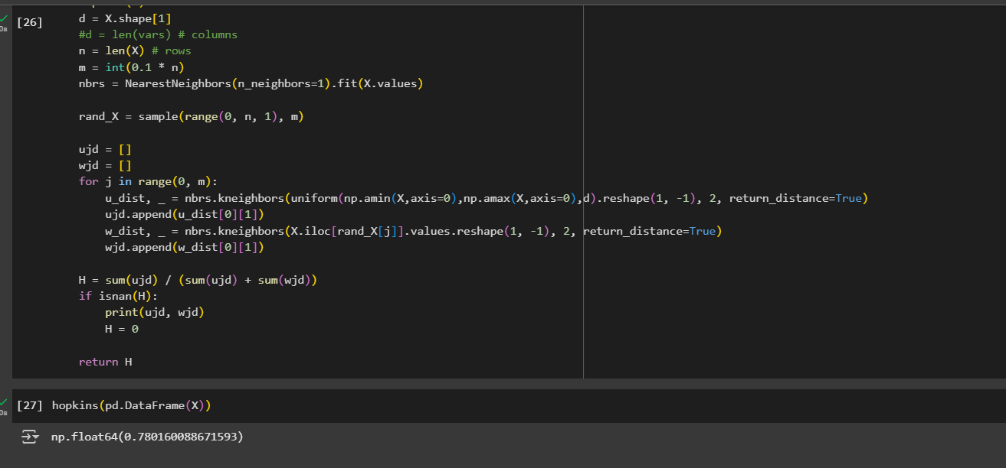
Hopkins Statistics:

Slide 10
Conclusion :
Web Scraping: Extracted detailed product data (~5000+ entries) including price, ratings, reviews, and categories from a real e-commerce test site using Python and BeautifulSoup.
Data Cleaning & Transformation: Handled missing values, duplicates, and standardized formats to ensure data quality and consistency.
Relational Storage: Used SQLAlchemy and SQLite to store cleaned data in a structured and queryable format for scalability and future use.
Unsupervised Learning: Applied KMeans clustering to group similar products, revealing distinct segments such as budget items, premium products, and popular choices.

Slide 11
Thank You

